Slide 1

6th International Slag Valorization Symposium
Mechelen
02-04/04/2019
Recovering chromium from stainless steel slag and ferrochrome slags
Frantisek Kukurugya, Liesbeth Horckmans, Jeroen Spooren
VITO NV

Slide 2
CHROMIC (H2020 project)
New recovery processes for critical and valuable metals
Current System
Smart combinations of existing methods and new technological innovations to extract valuable and critical metals from slags
Primary Ores
Scrap
Metal Production
CHROMIC
CS, SS, FeCr
ﬁne metals to production
Regenerated Leaching Solution
By-product: Slag
Nb Cr
Selective Material Recovery
Nb Cr
SS FeCr
Slag
Mo V
Mo V
To Metal Products
SS FeCr
efﬁcient mineral processing
Nb Cr Mo V
Selective Leaching
Cr
Dillute Leachate
Nb
Mo V
Metal Depleted Stream
Metal Depleted Stream
Use as construction materials
Use as construction materials

Slide 3
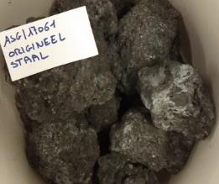
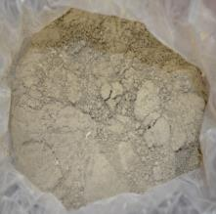
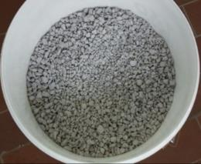
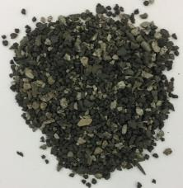
Chemical and mineralogical composition
XRF |  | CS slag | SS slag | LC FeCr slag | HC FeCr slag
Al₂O₃ | wt.-% | 10.0 | 4.2 | 6.5 | 17.9
CaO | wt.-% | 22.8 | 45.1 | 45.9 | 2.5
Fe_{tot} | wt.-% | 28.2 | 0.6 | 0.18 | 6.4
MgO | wt.-% | 3.7 | 11.0 | 12.6 | 14.9
MnO | wt.-% | 6.0 | 1.1 | 0.11 | 0.20
SiO₂ | wt.-% | 10.6 | 30.8 | 28.8 | 12.6
Cr | wt.-% | 2.6 | 2.5 | 3.2 | 11.5
Mo | mg/kg DM | 47 | 40 | <LLD | <LLD
Nb | mg/kg DM | 245 | 617 | <LLD | <LLD
V | mg/kg DM | 744 | 516 | 448 | 424
CS slag
(carbon steel slag)
SS slag
(stainless steel slag)
LC FeCr slag
(low carbon ferrochrome slag)
HC FeCr slag
(high carbon ferrochrome slag)
Material | Main minerals | Cr-rich phases
CS Slag | Ca-silicates (larnite, gehlenite), Fe-oxides (wuestite), spinel (Fe₃O₄, MgFe₂O₄) | Spinel (MgCr₂O₄)
LC FeCr/HC FeCr | Ca-silicates (merwinite, bredigite, larnite, gehlenite), spinel (MgAl₂O₄; MgCr₂O₄) | Ferrochrome particles, spinel MgCr₂O₄
SS slag | Ca-silicates (merwinite, bredigite, gehlenite, cuspidine), calcite | Spinel (MgCr₂O₄)
Challenges: low grade ores, spinel structure
Focus: Cr

Slide 4
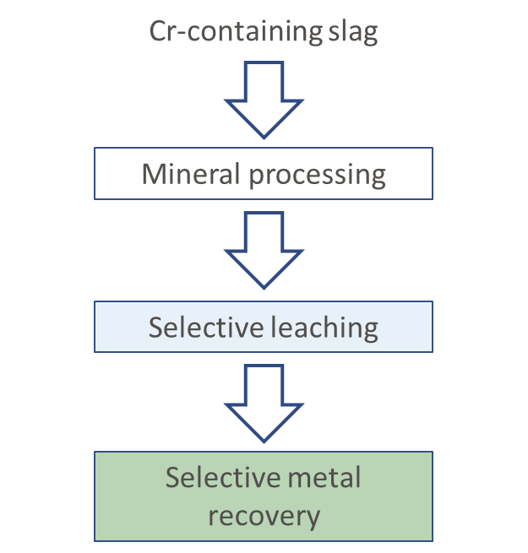
Introduction

Slide 5
Mineral processing

Slide 6
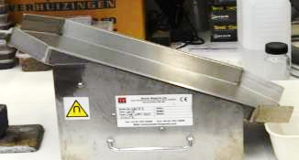
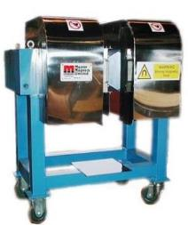
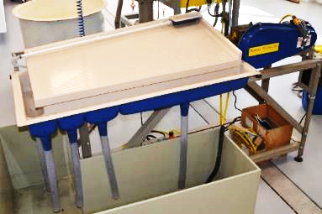


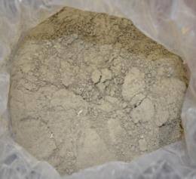
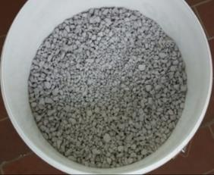
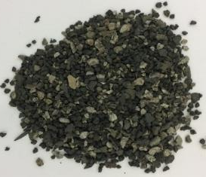
Mineral processing
Magnetic separation
Density separation
LIMS & HIMS
0.15T & 1T
WLIMS & WHIMS
0.1T & 1T
WHIMSe
0-2T
CS slag
SS slag
LC FeCr slag
HC FeCr slag

Slide 7
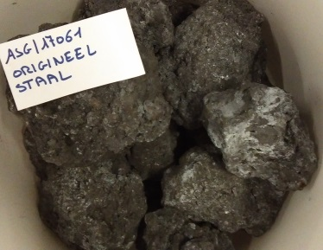
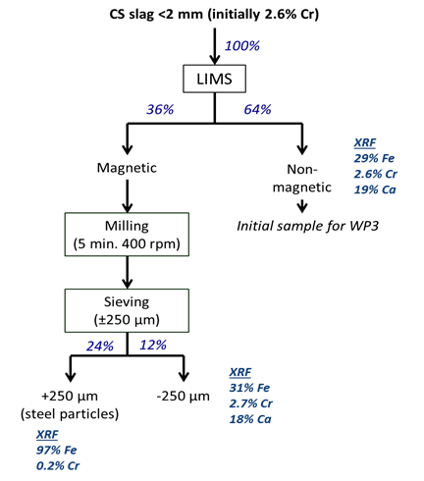
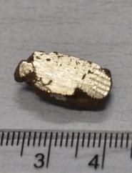
Magnetic separation – CS slag
(70% Fe recovery)

Slide 8
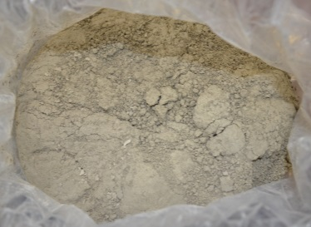
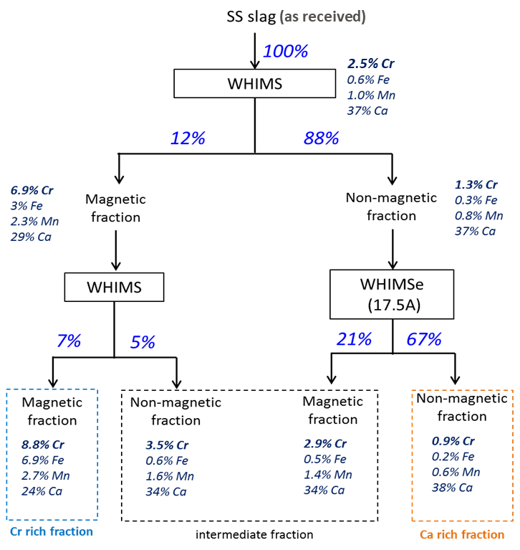
Magnetic separation – SS slag
Delivered as a fine powder – no need to crush or mill
D₉₀ = 150 µm
31% Cr recovery

Slide 9

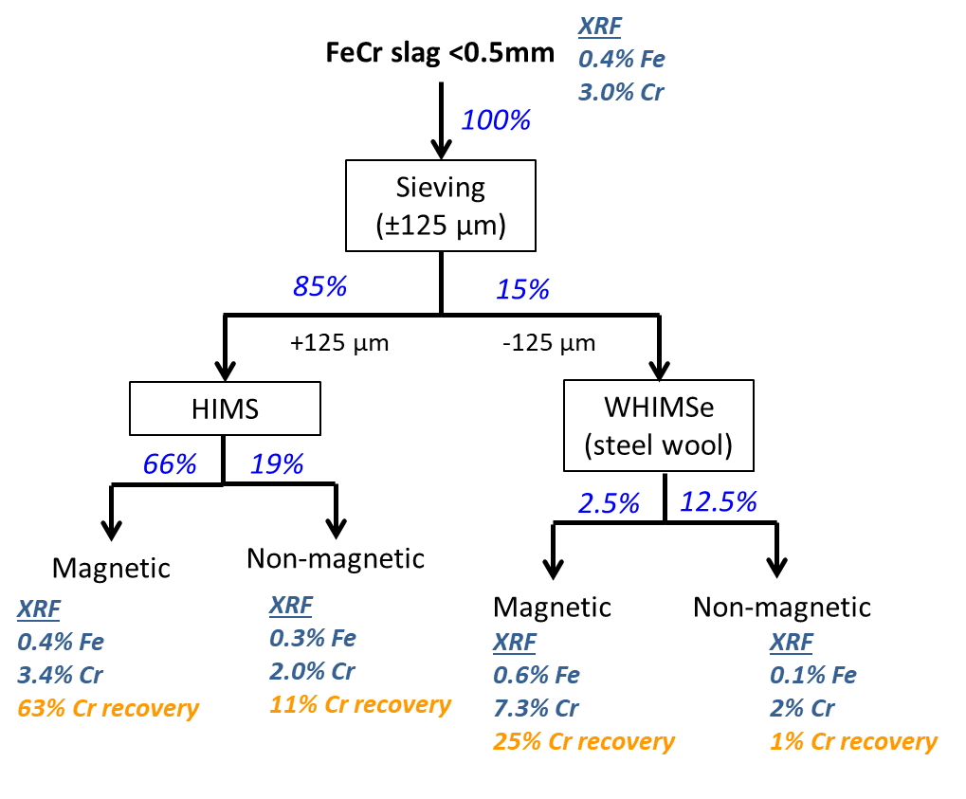
Magnetic separation – LC FeCr slag
FeCr
To use WHIMS(e) material needs to be milled <125 µm = extra costs

Slide 10
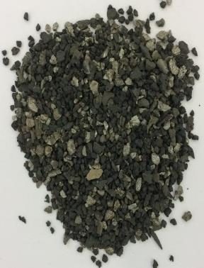
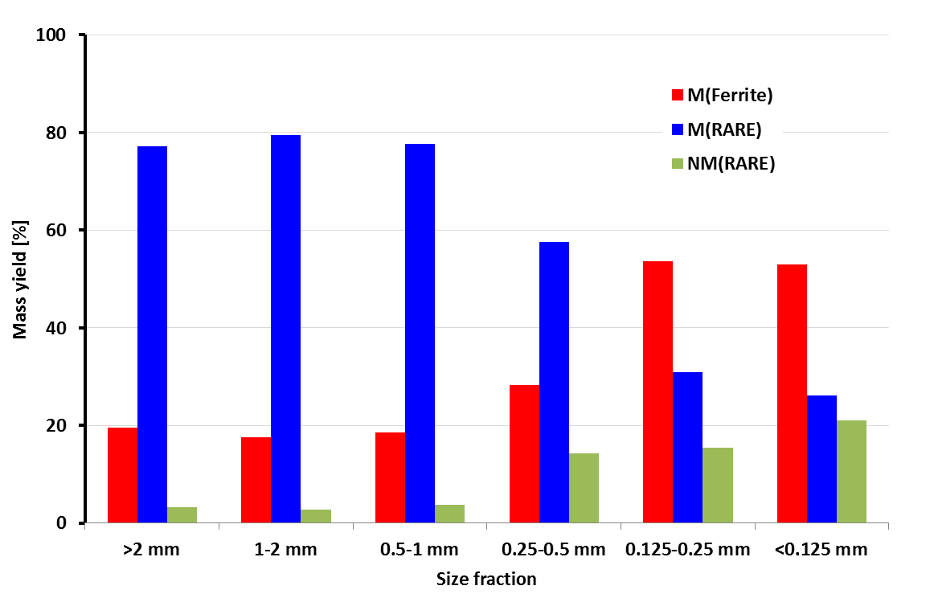
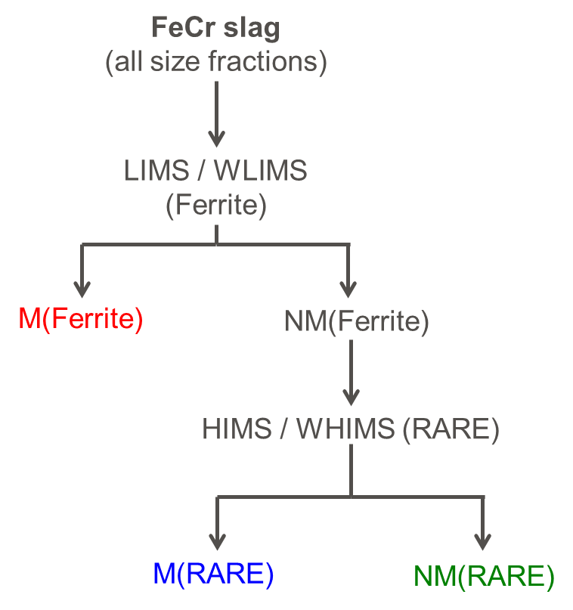
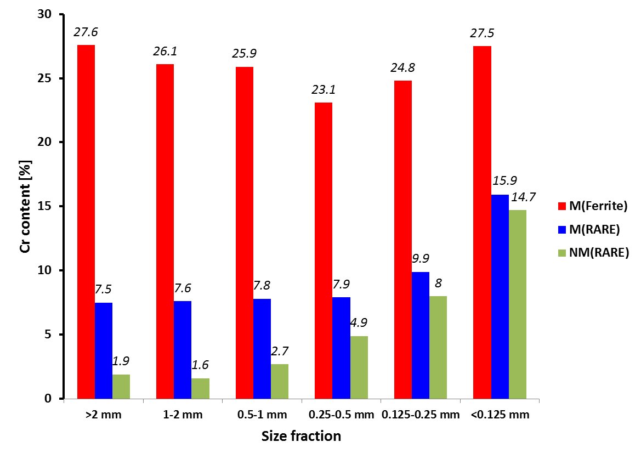
Magnetic separation – HC FeCr slag
50 – 75% Cr recovery in M(Ferrite) fractions

Slide 11
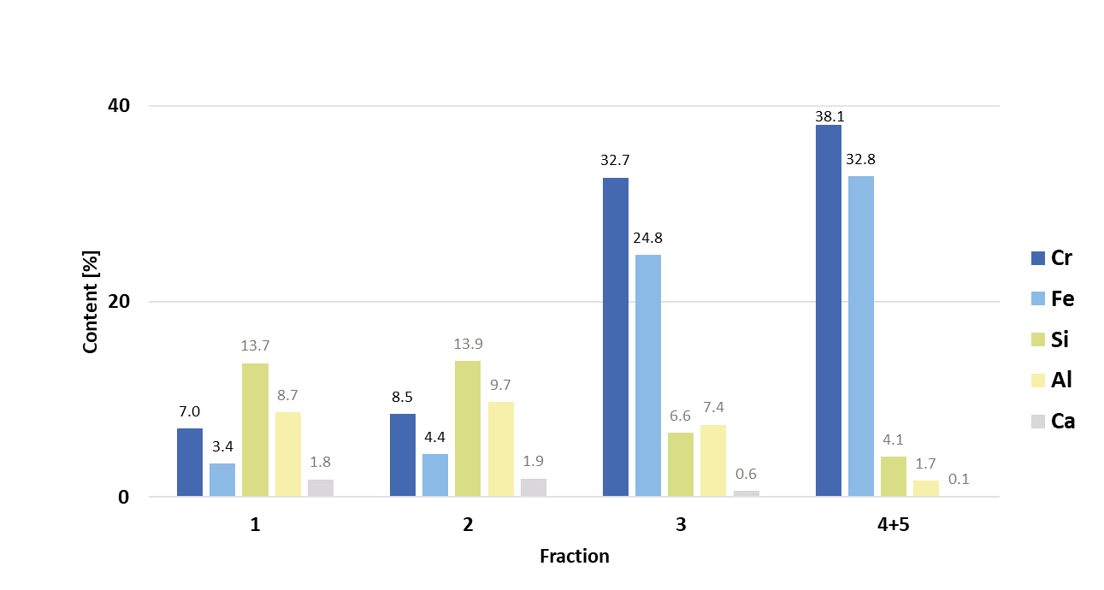
Density separation – HC FeCr slag
5 output fractions
stroke speed = 250 rpm
washing water = 1000 L/h
feed water = 250 L/h
Fraction 1
(56.0 wt.%)
Fraction 2
(32.4 wt.%)
Fraction 3
(11.3 wt.%)
Fraction 4
(0.2 wt.%)
Fraction 5
(0.1 wt.%)
1% Cr recovery
2% Fe recovery
35% Cr recovery
45% Fe recovery

Slide 12
Selective leaching

Slide 13
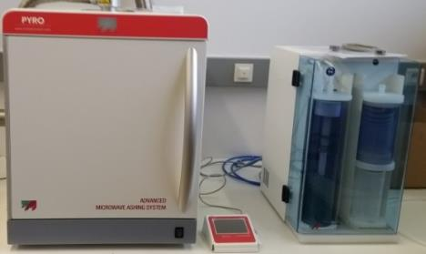
Selective leaching
Microwave assisted leaching => 100 – 200°C
Microwave assisted roasting followed by water leaching => ≥200 °C
FlexiWave – MW assisted leaching
PyroWave – MW assisted roasting
Using MW heating = fast, selective and effective heating
Alkaline leaching was selected to avoid of matrix dissolution

Slide 14
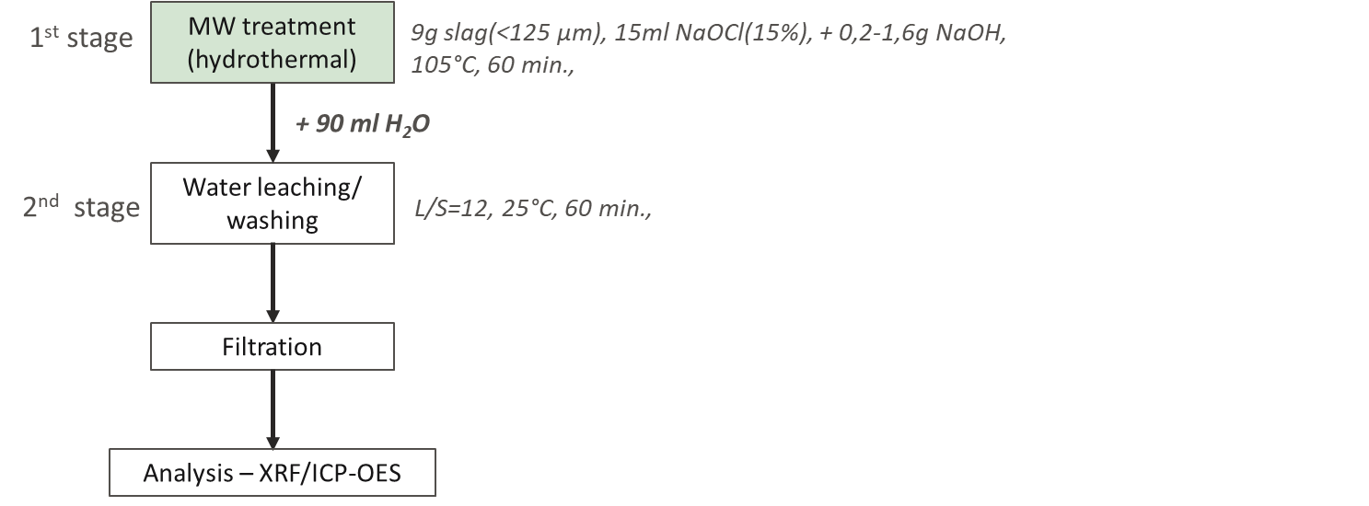
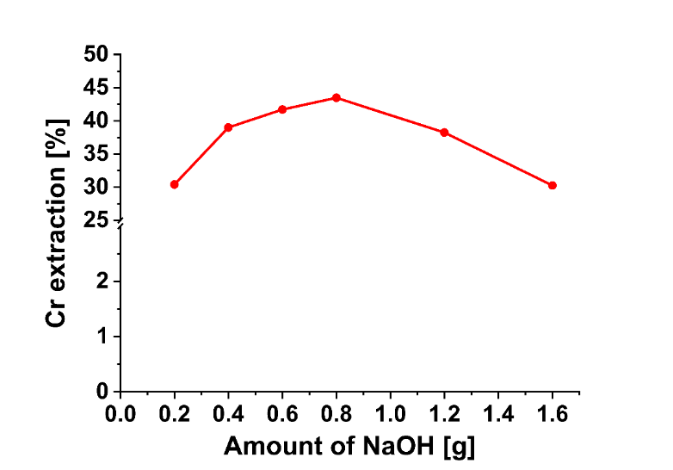
MW assisted leaching – CS slag
Effect of alkaline source (NaOH) addition
728 mg/L Cr
Results
455 mg/L Cr
44% Cr extraction after 1h MW treatment + 1h washing
dissolution of Al and Ca below 1%
<7.5mg/L V; <10 mg/L Mo, <40 mg/L Si, <100 mg/L Al,

Slide 15
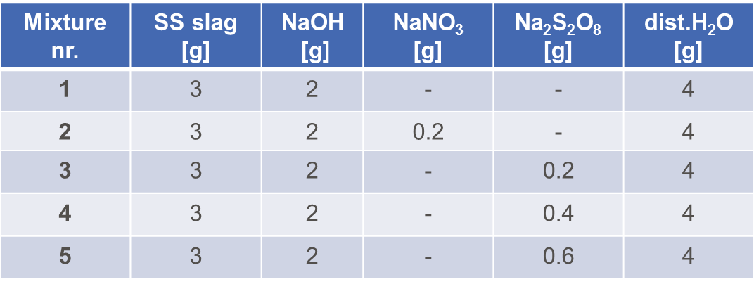
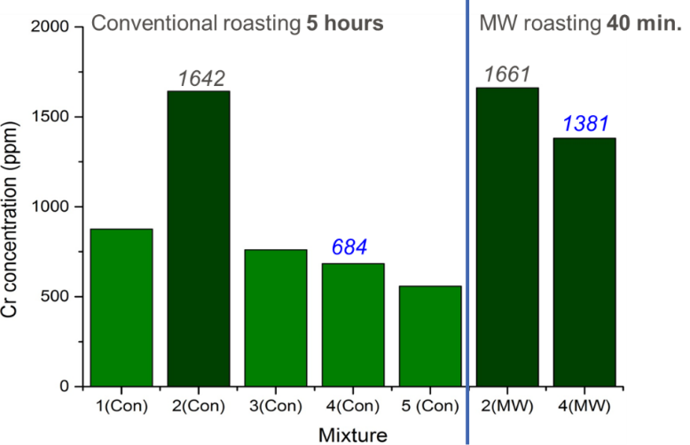
MW roasting and water leaching – SS slag
Results
Conventional roasting : 400°C for 2h (heating rate 120°C/h)
or
MW roasting: 400°C for 30 min. (+ heating time 10 min)
Water leaching: 50°C, L/S=10, 1h
95% Cr extraction was achieved with limited dissolution (<100 ppm) of Al, Ca and Mn
Cr content in solid residue decreases from 2% to 0.2%
Analysis (XRF, ICP-OES)

Slide 16
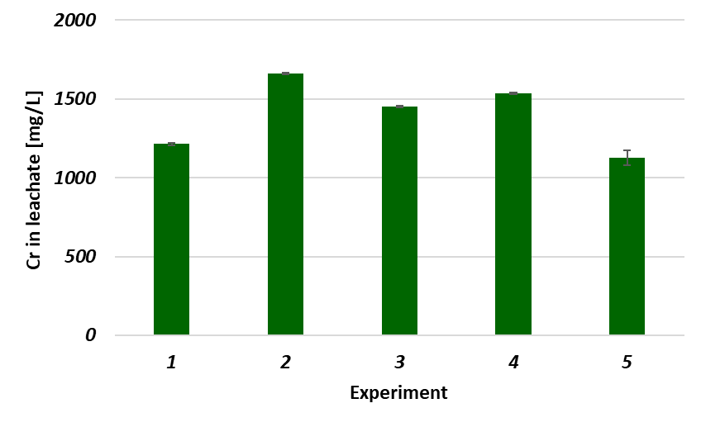
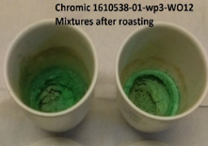
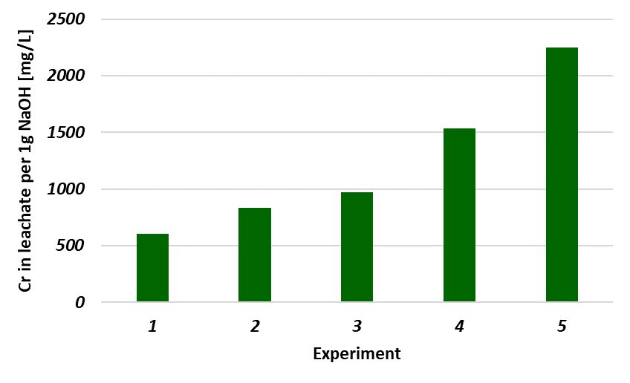
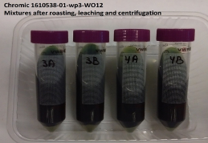
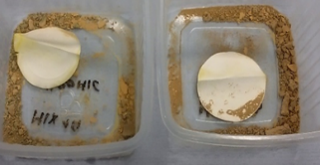
MW assisted roasting and water leaching – SS slag
Sample description:
1 - 3g sample + 2g NaOH
2 - 3g sample + 2g NaOH + 0.2g NaNO₃
3 - 3g sample + 1.5g NaOH + 0.2g NaNO₃
4 - 3g sample + 1g NaOH + 0.2g NaNO₃
5 - 3g sample + 0.5g NaOH + 0.2g NaNO₃
90%
MgCr₂O₄ + 4NaOH + $\frac{3}{2}$O_{2(g)} = MgO + 2Na₂CrO₄ + 2H₂O
After roasting
Leachate
(after washing)
Solid residue
(after washing)
50-180 mg/L Al; 40-150 mg/L Mn 70-230 mg/L Si
50-90 mg/L Ca; 10-12 mg/L V

Slide 17
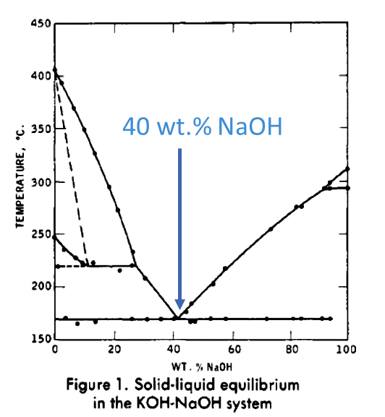
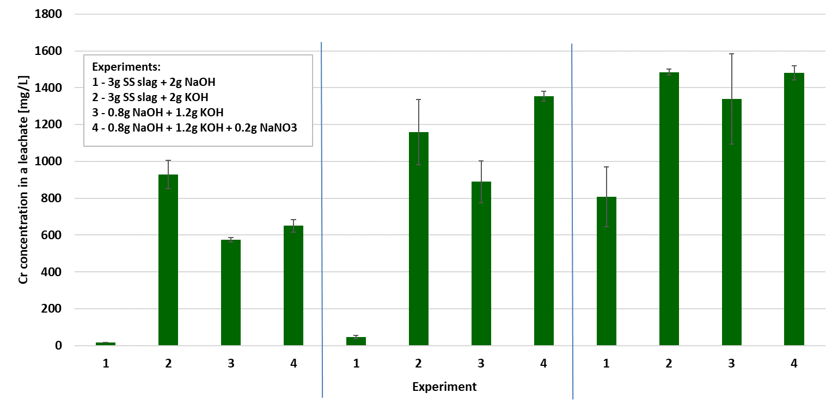
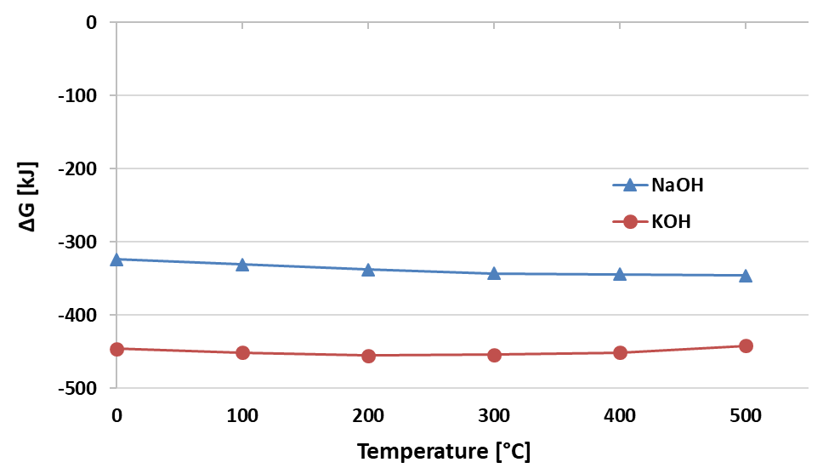
MW assisted roasting and water leaching
Is it possible to reduce roasting temperature?
200°C
300°C
400°C
90% Cr
MgCr₂O₄ + 4NaOH + $\frac{3}{2}$O_{2(g)} = MgO + 2Na₂CrO₄ + 2H₂O
MgCr₂O₄ + 4KOH + $\frac{3}{2}$O_{2(g)} = MgO + 2K₂CrO₄ + 2H₂O
Mixing with small amount of water ensure proper contact of reagents with Cr-spinel
Reaction with KOH has more negative ΔG values
No additional oxidant needed when KOH is used

Slide 18
Conclusion
Physical separation
By applying magnetic or density separation, Cr content can be increased by factor more than 3
Summary of the physical separation
Slag sample | Technique | Initial Cr [%] | Cr content after separation [%] | Yield [%] | Cr recovery [%]
LC FeCr | WHIMSe | 3.2 | 7.3 | 2.5 | 25
HC FeCr | LIMS | 11.5 | 27.6 | 20 | 50
SS | WHIMS | 2.5 | 8.8 | 7 | 31
HC FeCr | WST | 10.1 | 32.8 | 12 | 46
Selective leaching
MW heating show potential in recovering Cr from Cr-containing slags
More than 40% of Cr can be selectively extracted from CS slag by MW assisted leaching
More than 90% of Cr can be selectively extracted by MW roasting followed by water leaching

Slide 19











Thank you for your attention fero.kukurugya@vito.be

